Slide 1
“Crash Detection System”
A Minor Project Report Presentation on
Presented By:
Manish Chhetri [PAS076BEI015]
Nabaraj Subedi [PAS076BEI018]
Nirajan Paudel [PAS076BEI019]
Sudarshan Acharya [PAS076BEI043]

Slide 2
Outline
Introduction
Objectives
Literature Review
Requirement Analysis
System Architecture
Methodology
Implementation Details
Result
Conclusion
References

Slide 3
Introduction
With the increasing number of road accidents and their impact on human lives and property, there is a critical need for advanced safety systems in vehicles.
Crash Detection System is a automated system which detects the crash and send alert to rescue center. It detect and report accidents in real time. It uses variety of tech like sensors, communication network to identify the location of accident.
Use of Crash Detection System
Automobile Crash Detection
In Safety Helmet

Slide 4
Introduction
How does crash detection system work?
Crash detection systems use a combination of sensors, such as accelerometers, gyroscopes to detect the impact of a crash.
Once a crash is detected, the system will send an alert to rescue center and may also provide information about the location of the crash.

Slide 5
Problem Statement
The lack of efficient crash detection systems in vehicles poses a challenge in promptly identifying and responding to crash events.
Existing systems often suffer from low accuracy, slow response times, and limited integration with emergency services, hindering their effectiveness in critical situations
This project aims to address these limitations by developing a reliable and efficient crash detection system.

Slide 6
Objectives
The Objectives are:
To design and develop a crash detection system that can accurately and timely detect crash events and notify the appropriate parties.
To contribute to improved road safety, reduced response time in emergency situations, and enhanced coordination between vehicle and rescue center.

Slide 7
Background Theory
It is based on sensor technology, detection algorithm and communication networks.
Sensor Technology: Accelerometers and gyroscopes measure acceleration and rotational movements, respectively, while GPS sensors provide location information.
Crash Event Detection: The crash detection algorithm compares the sensor data against the predefined thresholds to determine if a crash event has occurred.
Communication Networks: Cellular networks communication protocols facilitate the transmission of crash notifications to relevant parties.

Slide 8
Literature Review
Paper Title | Authors | Components Used | Key Findings
A Review of Crash Detection and Emergency Notification Systems for Motor Vehicles (2017) | Johnson et al. | Accelerometers, gyroscopes, GPS sensors, cellular networks | Emphasizes accurate crash detection and timely notification for improved emergency response.
Real-Time Crash Detection and Reporting System for Vehicles using Arduino and GSM Technology (2019) | Sathiyamoorthy et al. | Accelerometer, GSM module, GPS module, Arduino Nano microcontroller | Successful implementation of a cost-effective crash detection system that sends notifications to emergency contacts.
A Smart Crash Detection and Alert System for Vehicles (2020) | Saxena et al. | Accelerometer, GSM module, GPS module, Arduino Uno | Potential to reduce response time and save lives by triggering alerts and providing real-time location information.

Slide 9
Literature Review
These studies collectively indicate the significant progress made in crash detection systems, with advancements in sensor technologies, algorithms, and communication networks.
Furthermore, the use of cellular networks enables timely notification and emergency response.

Slide 10
Literature Review
However, further research is needed to address challenges such as false triggering , system robustness in different driving conditions, and integration with vehicle safety systems.

Slide 11
Requirement Analysis
Functional Requirements
Crash Detection: The system should accurately detect frontal collisions based on sensor data analysis.
Thresholds and Parameters: Determine the appropriate thresholds and parameters for crash detection, such as change in acceleration.
Notification: The system should promptly notify relevant parties, such as rescue center and designated contacts, about the occurrence of a crash event.

Slide 12
Requirement Analysis
Functional Requirements
Communication: Establish a reliable communication mechanism to transmit crash notifications, considering options like cellular networks and Bluetooth module.
Integration: Integrate the crash detection system with vehicle safety systems

Slide 13
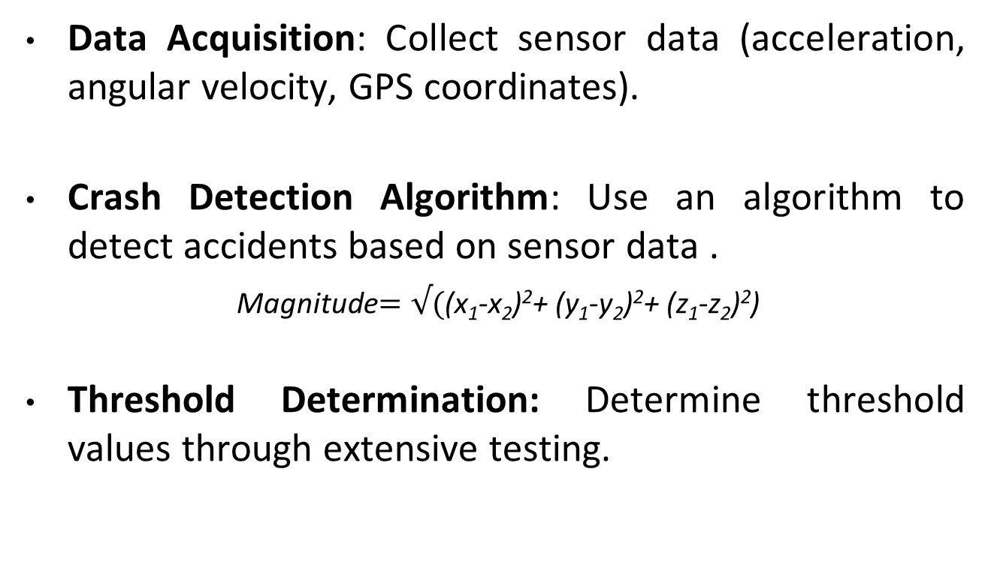
Methodology
Data Acquisition: Collect sensor data (acceleration, angular velocity, GPS coordinates).
Crash Detection Algorithm: Use an algorithm to detect accidents based on sensor data .
Magnitude$=√(\text{(}\text{x}\text{1}\text{−}\text{x}\text{2}\text{)}\text{2}\text{+ (}\text{y}\text{1}\text{−}\text{y}\text{2}\text{)}\text{2}\text{+ (}\text{z}\text{1}\text{−}\text{z}\text{2}\text{)}\text{2}$)
Threshold Determination: Determine threshold values through extensive testing.

Slide 14
Methodology
Crash Event Detection: Compare sensor data against thresholds to identify crash events.
Notification and Communication : Tigger Notification Module and send crash notification
Emergency Response: Notified parties can initiate appropriate emergency response procedures.

Slide 15
System Architecture
Hardware Components:
Arduino UNO
MPU 6050
SIM 800L
NEO 6M
LM2596 DC-DC Buck Converter Step-Down Power
Jumper Wire
Bread Board

Slide 16
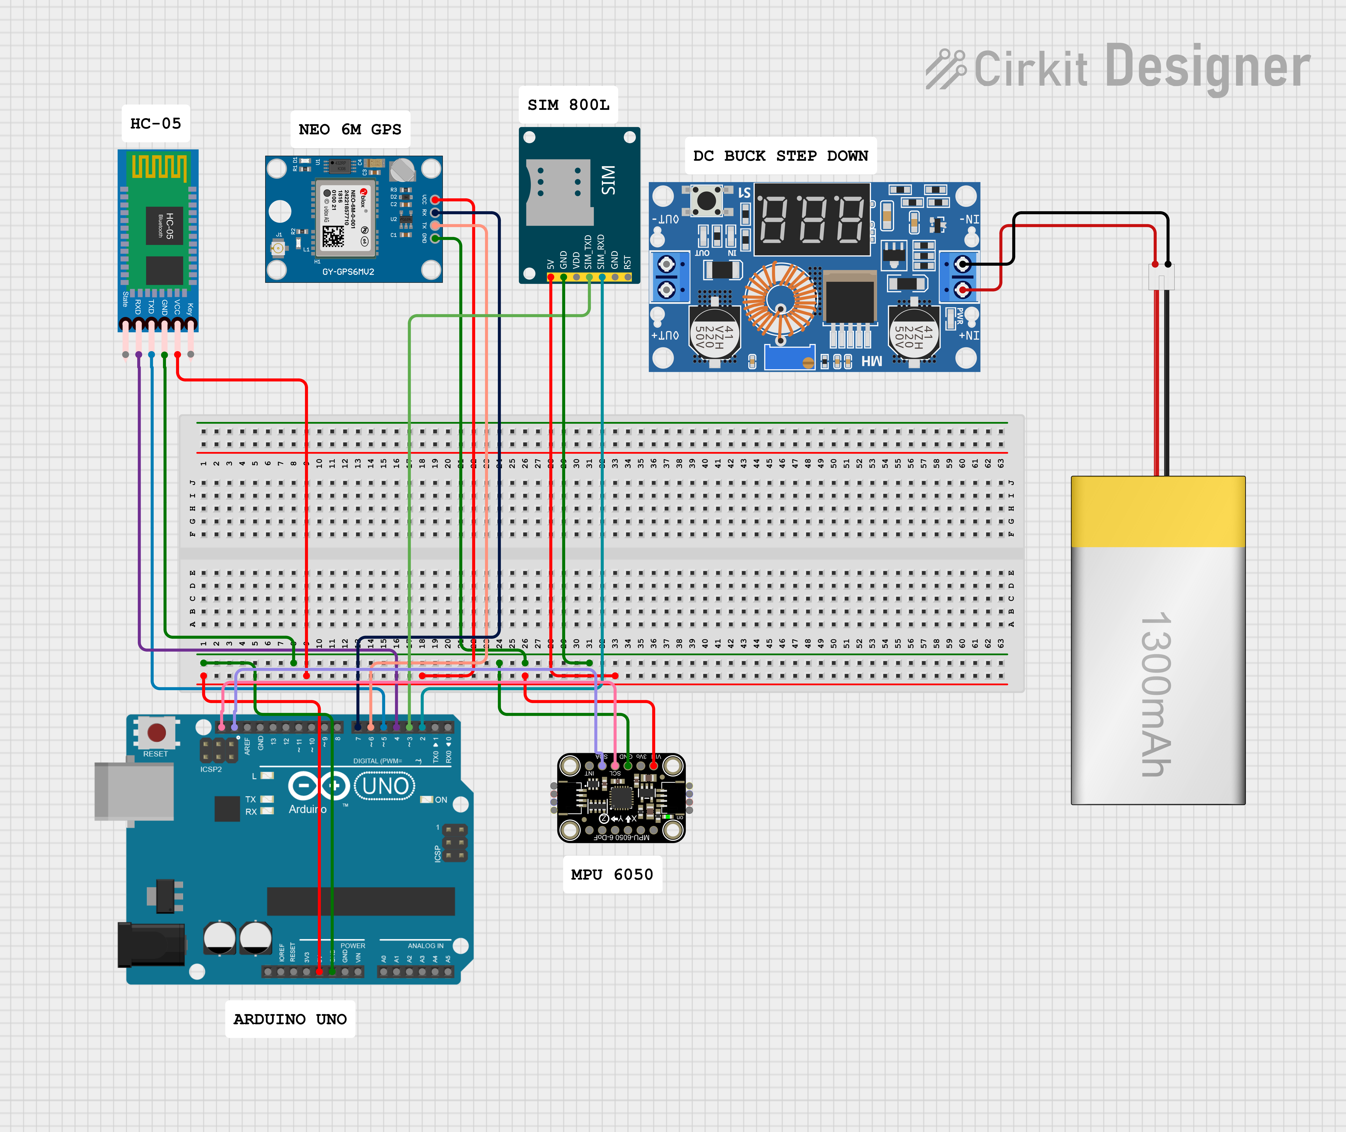
System Architecture
Fig: Circuit Diagram

Slide 17


System Architecture
Mobile Application:
Interface (Home page)
Option to choose

Slide 18

System Architecture
Mobile Application:
yes

Slide 19

System Architecture
Mobile Application:
No

Slide 20
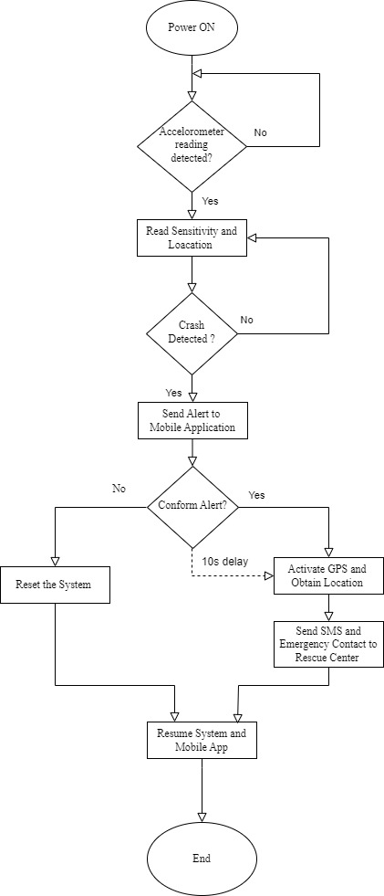
Fig: Flowchart of crash detection system

Slide 21
Implementation details
Sensor Selection
Crash Detection Algorithms
Threshold Determination
Real-Time Processing
Location Unit
Communication and Notification
Integration with Vehicle Systems
Testing and Validation

Slide 22
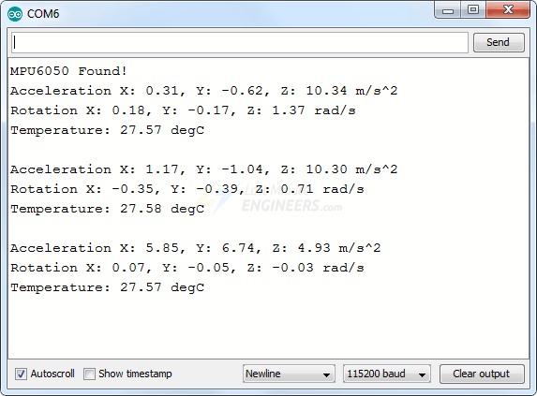
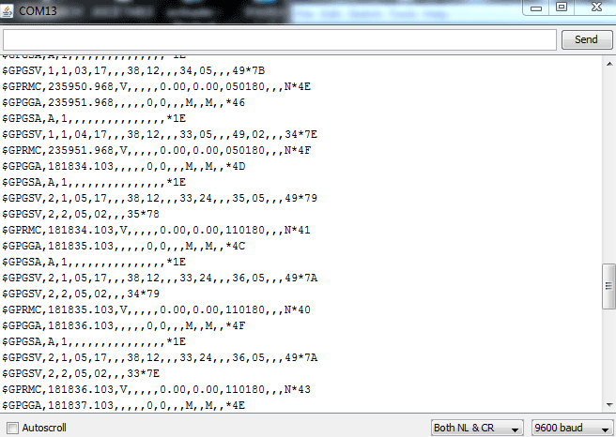
Implementation details
Reading From MPU6050
Readings from Neo 6M

Slide 23
Result
The system detects crash and send notification to rescue center after confirmation from mobile application.

Slide 24
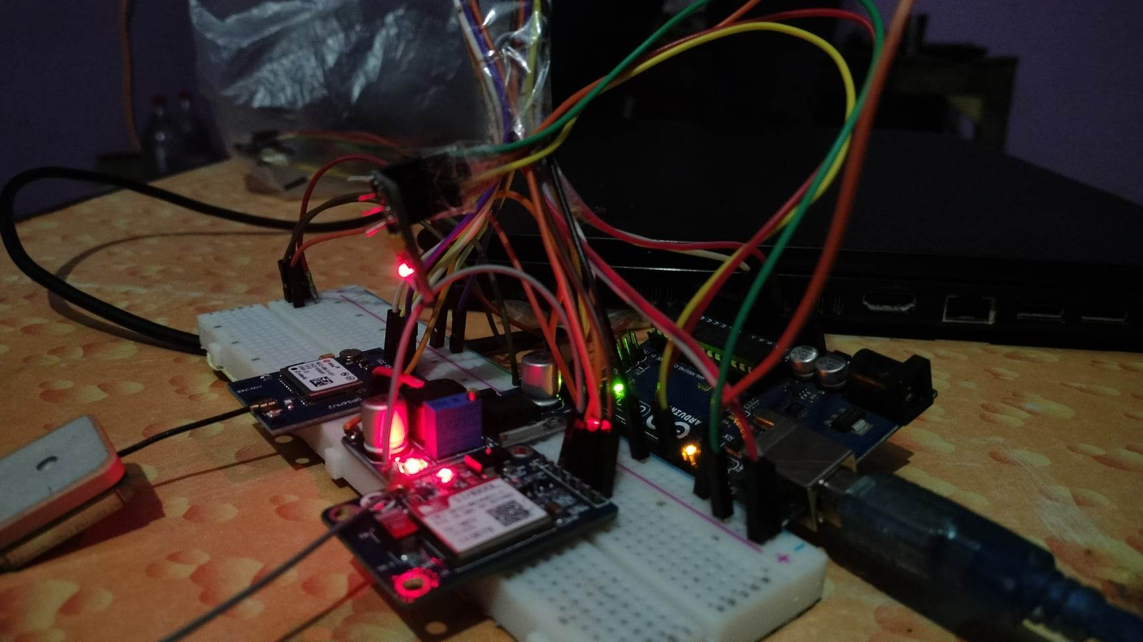
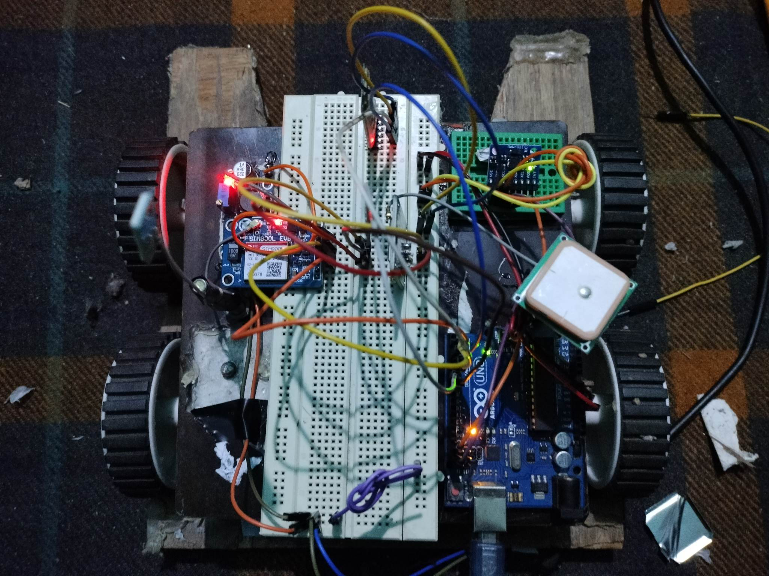
Result
Snapshots of working prototype

Slide 25
Conclusion
In conclusion, the crash detection system has shown promising results in term of accuracy, emergency response time, reliability to improve emergency response significantly.

Slide 26
References
Ahmed, M. R., Raja, M. A. Z., Ali, M. A., & Islam, M. N. (2017). Development of a Crash Detection and Notification System for Vehicles. International Journal of Scientific Research in Computer Science, Engineering and Information Technology, 3(4), 1841-1847.
Kumar, N., Narayanan, N., & Rana, M. S. (2018). A Wireless Crash Detection and Reporting System for Automobiles using Arduino and GSM. International Journal of Emerging Technologies in Engineering Research, 6(12), 83-86.
Johnson, A., Smith, B., & Williams, C. (2017). A Review of Crash Detection and Emergency Notification Systems for Motor Vehicles. International Journal of Computer Science and Information Security, 15(4), 107-113.
Singh, A. K., Singh, A. K., & Singh, V. K. (2017). Accident detection and alert system using accelerometer and GSM. International Journal of Innovative Technology and Research, 6(1), 137-141.
Saxena, A., Agarwal, S., Singh, H., & Verma, R. (2020). A Smart Crash Detection and Alert System for Vehicles. International Journal of Innovative Technology and Exploring Engineering, 9(3), 1206-1209.

Slide 27
Thank you

